Slide 1
Module 9
Continence Aids

Slide 2
Module Profile
Helps you:
Identify different continence aids
Determine which best suits a resident’s needs
for social continence, comfort & dignity
Know what to consider & assess
Notes:
In this session, we look at aids & appliances available to help manage residents’ urinary or faecal incontinence
It’s designed to help you:
identify different continence aids available,
determine which best suits a resident’s need for social continence, comfort & dignity
and to know what to consider and assess in selecting an aid or appliance

Slide 3
SELECTION
As short-term management strategy or long-term measure
Consider:
Type of incontinence
Amount of urine loss
Independence level
Personal preference
Notes:
Use of a continence aid or appliance may be a short-term strategy or long-term measure, depending on the resident’s needs
Before selecting a continence aid or appliance, a thorough continence assessment should be done of the resident
Consider their type of incontinence and amount of urine loss
Think about their independence level – physical ability, mobility, hand function. Do they require assistance with toileting, adjusting clothes and hygiene?
What about their personal preference? Will they be comfortable and happy with the chosen aid?

Slide 4
Selection
Aid should:
Contain the excretion
Contain / disguise odour
Be comfortable
Be easy to conceal under clothes
Be easy to use & manage
Be easily disposed of / cleaned
Notes:
Any compliance aid should be able to contain the excretion, contain or disguise odour, be comfortable, easy to conceal under clothes, easy to use and manage and be easy to dispose of or clean
Devices and equipment must be kept in safe and good working order. And be cleaned and disinfected according to the manufacturer’s instructions

Slide 5
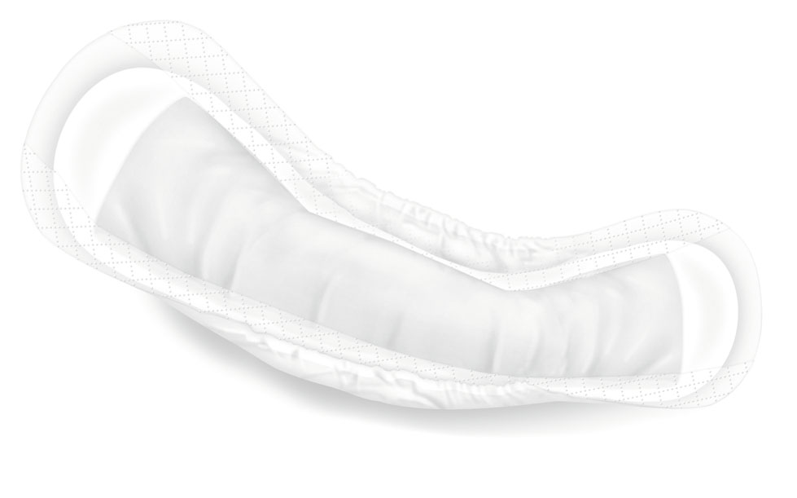
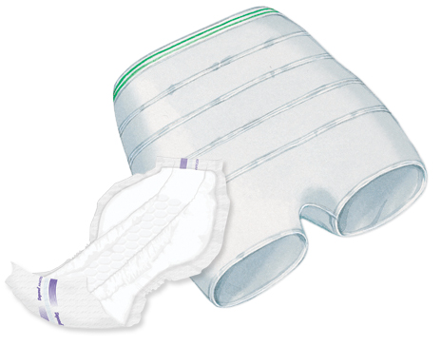

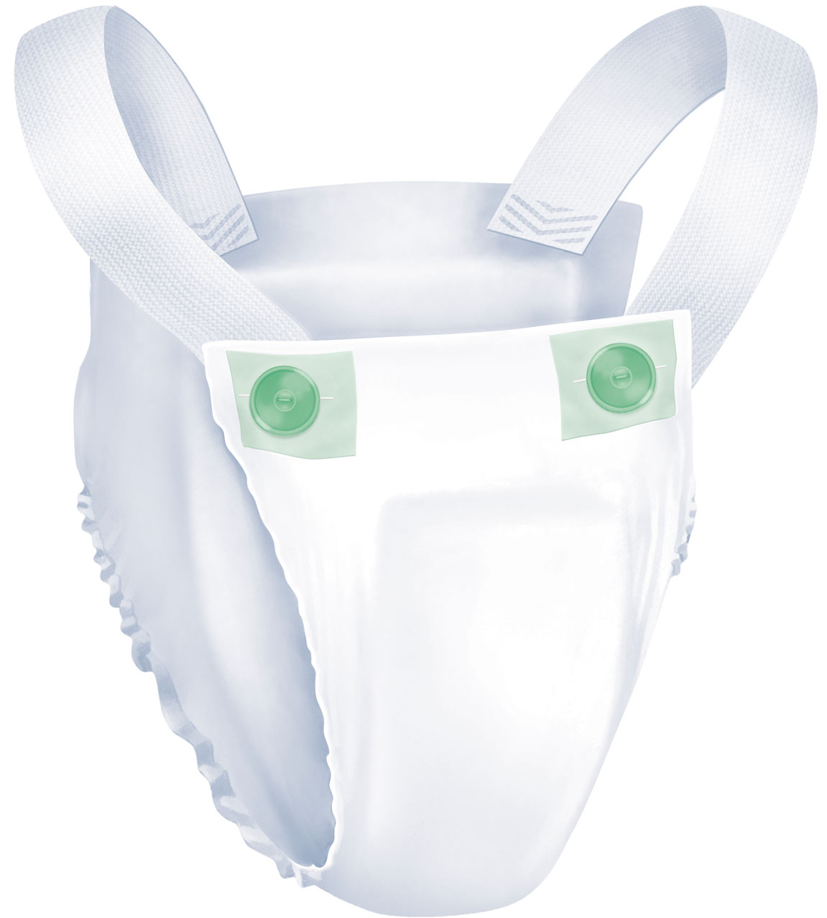
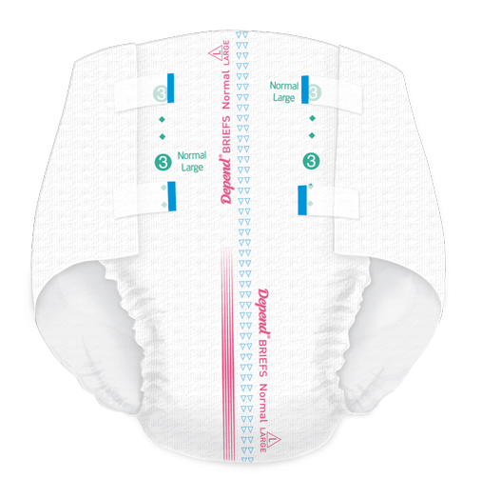
Different options
Disposable absorbent products
Light protection eg, POISE® pads
Pads or pants: all-in-one or
2 piece
Moderate protection eg, DEPEND® Undergarments
Heavy protection eg, DEPEND® Briefs or Anatomics
Notes:
There are a variety of continence aids available including disposable absorbent products, bed protection, toilet chairs, bedpans and more. We’ll explore various options over the next few screens
Disposable absorbent products can be in pad or pant style, all-in-one or 2 piece
They offer varying levels of absorbency from light to heavy. Some are designed for urinary leakage, while others protect against urinary & faecal incontinence.
For light incontinence, pads are usually used with an adhesive backing strip that adheres to underwear
For moderate incontinence, undergarments that hang from the hips may suit independent residents. Disposable underwear with elasticised gathers may suit residents who would not tolerate a pad.
For heavier incontinence, consider anatomic shaped pads held in place by Depend® Stretch Pants or residents’ firm-fitting underwear.
Options for heavy incontinence may include a brief or all-in-one designed to wrap around the body and seal with adhesive tabs. These hold a large amount of urine so are ideal for residents who can’t toilet themselves or do not wake for night toileting.
For faecal incontinence, booster pads can be inserted into an absorbent product for extra protection.
Kimberly-Clark’s Poise and Depend ranges offer a variety of disposable protection options.

Slide 6
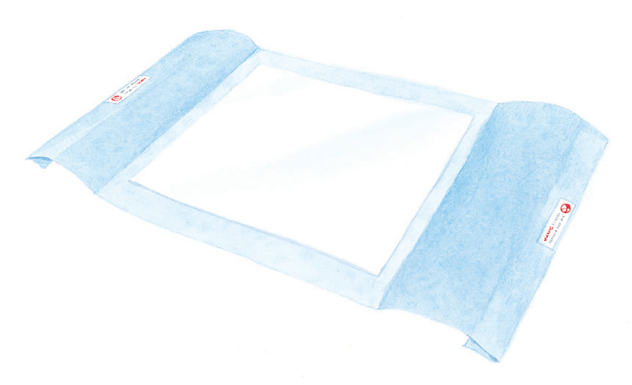

Different options
Bed protection
Mattress covers
Disposable underpads
Drawsheets
Reusable bed pads
Notes:
Bed protection may include mattress covers, disposable underpads, drawsheets and reusable bed pads
This helps protect the mattress and saves on clean up time
Pictured here are Kimberly-Clark’s disposable Bed Protector and also Underpads, which offer protection for a variety of surfaces including chairs.

Slide 7
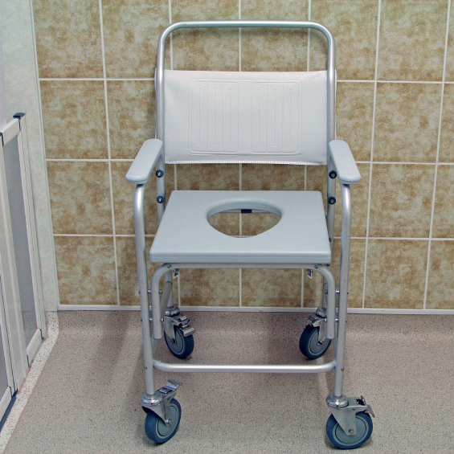
Different options
Disposable wipes
Reusable products
Commodes or toilet chairs
Urinals
Bedpans
Male external collection devices
Appropriate clothing
Catheters
Notes:
Let’s look at some more continence aid options:
It’s important to clean urine or faeces from residents’ skin to prevent skin problems. Wipes should be free of alcohol and soap so they’re gentle on sensitive skin to avoid skin irritation.
Reusable products may include waterproof pants with reusable or disposable pad inserts, all-in-one or 2 piece systems, and retaining garments for pads. Reusable products are only appropriate for urinary incontinence.
Commodes or toilet chairs can make toileting easier.
Urinals may be used for men or women. External collection devices for men include dribble pouches, penile sheaths and body-worn appliances
Some types of clothing are more appropriate for elderly people with continence challenges: elastic waistlines and Velcro are easier to manipulate than zips and buttons. Full skirts rather than tight-fitting and nightshirts rather than pyjamas are both easier to manipulate and also make wearing product more discreet.
Catheters may be indwelling or intermittent.

Slide 8
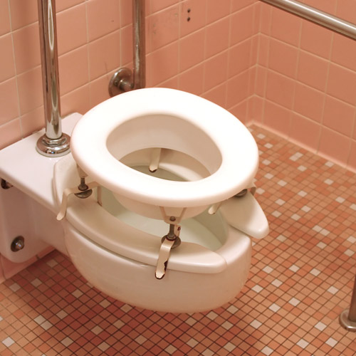
Environmental modifications
Mobilising aids
Hand rails
Toilet seat raisers or over-toilet frames
Appropriate toilet arrangements
Visual aids / signage
Notes:
Modifying a resident’s environment may help them get to and use the toilet more easily and effectively
Things like hand rails and / or raising the toilet seat or using an over-toilet frame can make getting on and off the toilet easier and provide stability
It’s important to have in place appropriate toilet arrangements – that the toilet is private and clean, there’s a call bell and that toilet paper is within easy reach. Another consideration could be providing a hook or shelf for people to stow their personal items while using the toilet
Visual aids include having adequate lighting and also possibly having signage, especially helpful for residents who may get confused or have memory problems

Slide 9
summary
Determine which best suits a resident’s needs by looking at the following:
Incontinence type & amount, independence, preference
Aid to contain, be comfortable, easy
Disposable absorbent products
Bed protection
Re-usable products
Commodes, bed pans, catheters
Environmental modifications
Notes:
Residents with continence challenges require an individualised management plan to help them
When choosing a continence aid for a resident remember to consider their type of incontinence, amount of loss, their independence level and their personal preferences
The aid should contain the excretion and odour, be comfortable and easy to conceal under clothes, and easy to use and manage
Aids may include disposable absorbent products and wipes, bed protection, re-usable products, commodes, urinals and bedpans, catheters – and remember some types of clothing are more appropriate
Adjusting the environment can make toileting easier and more effective

Slide 10
This certifies that
Name:
has attended the continence management session
Module 9: Continence Aids, Appliances & Products
Date of Completion_______________________________

