Slide 1
Module 3
Introduction to Urinary Incontinence

Slide 2
Module Profile
Outlines roles of multi-disciplinary team members in managing urinary incontinence
Highlights strategies for managing residents’ continence issues
Will help you:
List health professionals that may be involved
Identify continence-related therapies & management styles
Notes:
While elderly residents’ continence problems are often not curable, significant improvements can be made to their continence status by adopting an individualised & effective continence management plan

Slide 3
Multi-disciplinary Team
Nurse/Carer
Medical Practitioners
Continence Nurse Advisors
Physiotherapist
Occupational Therapist
Dietician
Notes:
While carers & nurses are the primary care givers, a multi-disciplinary team approach may optimise desired outcomes
Nurse/Carer – assists with management by implementing care such as toileting, hygiene and skin care, application of aids, evaluates effectiveness of aids
Involved with assessments such as urinalysis, continence assessments, urinary assessment & recording of ACFI data; Also coordinates care & referrals
Medical Practitioners – Review & prescribe medication, Order clinical tests, Make referrals to medical specialists, CNAs & physios
Continence Nurse Advisors – Specialise in treating incontinence, Can provide professional assessments & advise re appropriate management
Physiotherapist – Assesses residents’ mobility and dexterity including pelvic floor, Provides exercises to address needs
Occupational Therapist – Help residents towards independence in Activities of Daily Living including hygiene & toileting
Dietician – Reviews diet & fluid status, Advises on appropriate diet & fluids to improve continence, Assists with weight management program for obese clients as obesity can contribute to incontinence

Slide 4
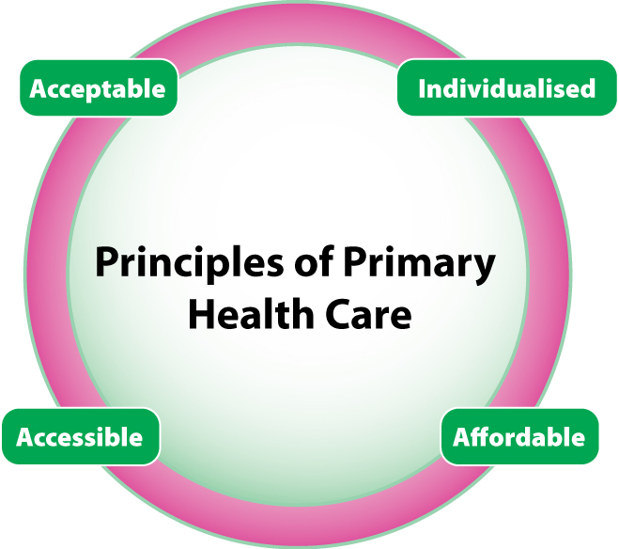
Management Strategy
Based primarily on
the nursing diagnosis
Influenced by:
Type of incontinence, and
Cause of incontinence
Notes:
Management of incontinence must address the principles of primary healthcare so programs or plans should be individualised, acceptable, affordable and accessible.

Slide 5
Therapies / Strategies
Identifying / treating common underlying problems, such as:
UTI
Constipation
Menopause
Obesity
Delirium
Chronic cough
Impaired mobility
Impaired manual dexterity
Prostate enlargement
Drug side effects
Notes:
We see here & over the coming slides various strategies that can be implemented in managing & caring for a resident with continence issues

Slide 6
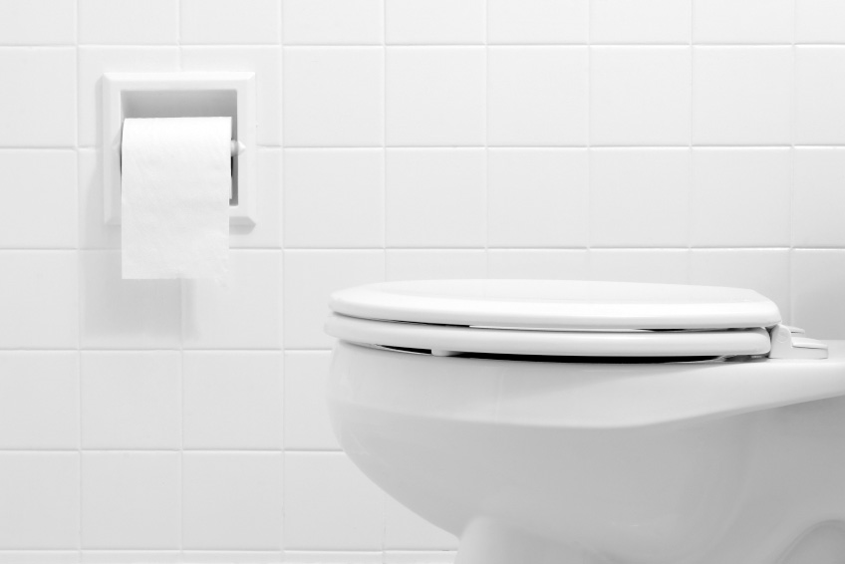
Therapies / Strategies
Improving environment &
assisting with mobility:
Bed & chair & toilet height
Bars & hand rails
Lighting & signs
Floor surfaces
Clothing
Toilet acceptability
Adequate privacy & comfort
Notes:
This involves reviewing environmental objects & fittings & modifying as required

Slide 7
Therapies / Strategies
Hygiene & skin care
Selection & application of continence aids
& appliances
Pads
Pants
Sheaths
Body-worn appliances
Drawer sheets
Bed pads & bedding protection
Notes:
Cleansing the skin of urine & faeces between pad changes maintains residents’ skin integrity & reduces potential for skin breakdown
Skin cleansers or no-rinse solutions may be preferable, as soap can be dry & harsh on ageing or delicate skin
It’s important to select the most appropriate & effective product & continually review its effectiveness

Slide 8
Therapies / Strategies
Maintaining physiological function of resident
Promote good bladder & bowel habits
Review fluid intake including amount & types
Diet
Exercise
Review of medications
Referral to appropriate
health professional
eg, Doctor, Continence Nurse Advisor,
Physiotherapist, Dietician

Slide 9
Therapies / Strategies
Bladder retraining
Toileting schedule, prompted voiding & timed voiding
Pelvic floor exercises
To strengthen muscles around bladder & bladder opening
Catheterisation
Where medically indicated eg, urinary retention
Notes:
Bladder retraining techniques might help treat urgency, frequency & functional incontinence
Pelvic floor exercises may be recommended for both women & men experiencing any degree of urinary leakage

Slide 10
Therapies / Strategies
Surgery
If indicated
Complementary therapies
Hypnotherapy
Acupuncture
Psychotherapy
Homeopathy
Reflexology
Aromatherapy
Notes:
Complementary therapies may be considered in helping manage continence issues on a case-by-case basis

Slide 11
This certifies that
Name:
has attended the continence management session
Module 3: Managing Urinary Incontinence
Date of Completion_______________________________

