Slide 1
Module 11
Infection Control

Slide 2
Module Profile
This module will help you:
Understand effective hand hygiene practices
Describe precautions
Be aware of health care workers’ vaccination needs
Know appropriate response following occupational exposure to body fluids
Notes:
Contact with blood, body fluids and oral secretions occurs in aged care facilities so it’s important to understand and follow infection control.
Health care workers and residents can be exposed to germs. Proper infection controls can prevent spread of infection
This module is designed to help you understand effective hand hygiene practices, precautions, and to know the appropriate response if you’re exposed to body fluids
It also looks at health care workers’ vaccination needs

Slide 3

Hand hygiene
Hands are the most common way infection is spread in aged care facilities
Routine hand washing technique
Wet hands with water
Apply metered amount of pH-neutral liquid hand wash
Rub vigorously over all surfaces up to forearms for min 10–15 secs
Rub between fingers, fingertips, thumbs & wrists
Rinse well with warm running water
Pat hands dry with paper towel & discard in bin
Notes:
Did you know that hands are the most common way infection is spread in aged care facilities?
Hands must be cleaned when visibly dirty, after touching contaminated items with your bare hands, before & after direct contact with residents, before & after applying gloves, after having direct physical contact with a person, their body fluids or belongings, before & after contact with food or using the toilet, after blowing your nose, coughing or sneezing – and before and after smoking
The routine hand washing technique is to wet hands with water, apply a metered amount of pH-neutral liquid hand wash and rub vigorously over all surfaces up to your forearms for 10–15 seconds at least. Rub between fingers, fingertips, thumbs and wrists and then rinse well with warm running water. Pat hands dry with paper towel & discard in the bin.
Waterless alcohol-based skin cleanser should only be used when hands are not visibly soiled. Apply a metered amount to the palm of one hand & rub hands together covering all surfaces of your hands, fingers & wrists until dry.
Make sure your hands are dry before putting on gloves & wash hands with soap & water when you feel a build up of emollients.
Keep jewellery to a minimum.
To prevent dry skin, moisturise your hands with barrier cream before each break & when going home.
Cover cuts & abrasions with waterproof dressing and always report skin conditions to your manager.

Slide 4

Chain of Infection
Infectious agent
Microorganism with ability to cause disease
eg, bacteria, virus, fungi, parasites.
Susceptible host
Reservoir
Person who can’t resist microorganism invading their body, multiplying & resulting in infection
eg, babies, pregnant women, elderly, immunosuppressed
Place within which microorganisms can thrive & reproduce
Portal of entry
Portal of exit
Provides a way for a microorganism to leave the reservoir
eg, nose, mouth, faeces
Any opening that allows
a microorganism to enter
eg, body orifices, mucous membranes, breaks in skin
Mode of transmission
eg, health care workers’ hands may carry bacteria from one person to another
Notes:
Understanding the chain of infection and the characteristics of each link can help you recognise methods to prevent the spread of infection & to protect yourself
We’ll start by looking at mode of transmission which could include a health care worker’s hands that carry bacteria from one person to another. The portal of entry is any opening that allows a microorganism to enter the host – for example body orifices, mucous membranes, breaks in skin. A portal of entry could also be created from tubes placed in body cavities such as urinary catheters – or from punctures produced by invasive procedures such as intravenous fluid replacement.
A susceptible host is a person who cannot resist a microorganism invading their body, multiplying and resulting in infection. For example, babies, pregnant women, the elderly and immunosuppressed.
An infectious agent is a microorganism with the ability to cause disease such as bacteria, virus, fungi or parasites. Microorganisms thrive in humans, animals and water & on inanimate objects like table tops & door knobs.
A reservoir is a place within which microoganisms can thrive & reproduce
A portal of exit is a way for a microorganism to leave the reservoir, such as the nose, mouth or faeces.

Slide 5

Standard precautions
Minimum routine practices may include:
Hand hygiene
Personal protective equipment
Use of aseptic technique
‘clean technique’ to reduce infectious agents
when doing simple wound care wash hands thoroughly & frequently, wear appropriate protective apparel & use a non-touch technique
Safe management of laundry & linen
Appropriate reprocessing of used instruments & equipment
Safe handling & disposal of clinical & general waste & sharps
Notes:
Standard precautions are the minimum routine practices which heath care workers must adhere to. They may include hand hygiene, personal protective equipment, use of aseptic technique, safe management of laundry & linen, appropriate reprocessing of used instruments & equipment – and safe handling & disposal of clinical & general waste & sharps
Standard precautions are designed to reduce the risk of transmission of germs from known & unknown sources of infection
They should apply to the care & treatment of all residents when there’s potential for contact with blood, all body fluids, excretions, secretions (except sweat), non-intact skin and mucous membranes
Aseptic technique is applying clean technique to routine work practices to reduce infectious agents. When doing simple wound care, wash hands thoroughly & frequently, wear appropriate protective apparel & use a non-touch technique

Slide 6

Personal protective equipment
Includes:
Gloves
Masks / face shields
Protective eyewear
Aprons
Gowns
Use
Apply before resident contact
Apply & remove carefully so as not to spread contamination
Remove & discard in appropriate skips
Immediately perform hand hygiene
Notes:
Personal protective equipment may include gloves, masks or face shields, protective eyewear, aprons and gowns
It should be applied before contact with a resident, and applied & removed carefully so as not to spread contamination.
Remove & discard in appropriate skips & immediately perform hand hygiene.

Slide 7
Equipment & linen
Ensure re-usable equipment is appropriately cleaned & reprocessed BEFORE use for another resident
Discard single-use items properly
Place linen that’s wet or heavily soiled with body fluids in impermeable bag & tie securely
Do not rinse or sort linen in resident care areas
Tie off all linen bags securely when 2/3 – 3/4 full
Notes:
It’s important to handle resident care equipment that’s soiled with blood, body fluids, secretions & excretions in a manner that prevents skin & mucous membrane exposures, contamination of clothing & transfer of microorganisms to other residents & the environment
Ensure re-usable equipment is not used for another resident’s care until it’s cleaned & reprocessed appropriately
Ensure single-use items are discarded properly
Place linen into appropriate laundry bags at point of generation. Linen that’s wet or heavily soiled with body fluids should be placed in impermeable bags & tied securely
Linen should not be rinsed or sorted in resident care areas. Linen bags should be tied securely when 2/3 to ¾ full

Slide 8
Handling waste
Waste should be segregated at point of generation into:
General incl. recyclable
Clinical (medical)
Any used sharp object
Visibly blood stained
Containers of body substance
Human tissue / lab specimens
Any other material classified by Infection Control or OH&S at your facility
3. Cytotoxic
Notes:
When handling waste, standard precautions must be followed.
There’s a legal obligation to classify waste correctly: General including recyclable, Clinical which is medical, and cytotoxic.
Clinical includes any used sharp object, any visibly blood stained materials or items, containers of body substance, human tissue or lab specimens, and any other material so classified by Infection control or OH&S at your facility.

Slide 9
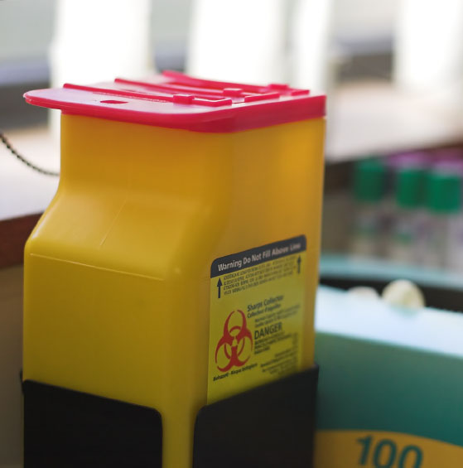
Sharps Handling
Dispose in sharps bin at point of use
Never pass by hand to another person
Do not re-cap needles or other sharps
Never bend or break needles
Dispose of needles & syringes as one unit
Notes:
Always take care when handling sharps. The person generating the sharp waste is responsible for its safe disposal. Dispose of them in the sharps bin at point of use, never pass by hand to another person, don’t re-cap needles & other sharps, never bend or break needles & dispose of needles & syringes as one unit.
When the sharps container – which must conform to Australian Standards – is ¾ full, seal it carefully and discard it as clinical waste.

Slide 10
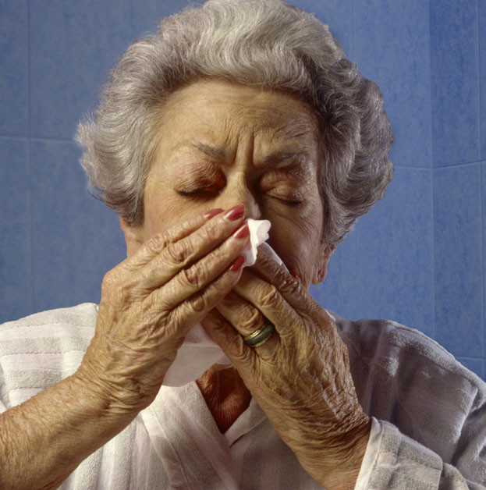
Potential transfer
Infection transfer could be:
Contact
eg, infections like MRSA, scabies, shingles
Droplet
eg, influenza, whooping cough
Airborne
eg, pulmonary tuberculosis, influenza
Notes:
Infection could be transferred by contact such as with infections like MRSA, scabies and shingles – or via droplet like with influenza & whooping cough. Or it may be airborne such as with pulmonary tuberculosis or influenza.

Slide 11
Additional precautions
One or a combination. For eg:
Use of single room with ensuite
Appropriately worn personal protective equipment
Room sharing by residents with same infection
More frequent / thorough room cleaning
Negative air pressure (discharged directly outside) for airborne
Dedicating equipment for use with particular resident
Door sign asking people to consult nursing staff before entering
Consideration of staff immunity
Notes:
When it comes to additional precautions for guarding against spread of infection, one or a combination may be required.
Room sharing by residents with the same infection might be appropriate if single rooms are not available. Or you might use single rooms with an ensuite.
Carers could wear appropriate personal protective equipment and possibly there may be some selectivity with care. For example, staff not immune to chicken pox not caring for residents with shingles.
Rooms may need to be cleaned more frequently or thoroughly and particular equipment might be dedicated for use with a particular resident
Other possibilities are negative air pressure, discharged directly outside, for airborne infections. And / or a door sign asking visitors to consult nursing staff before entering

Slide 12
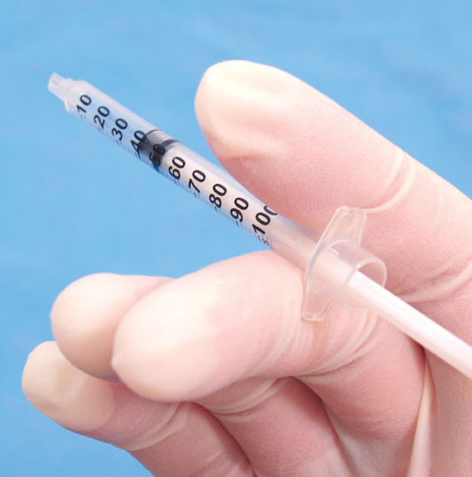
Workers’ vaccines
May include:
Hepatitis A if working in rural indigenous communities
Hepatitis B for all patient care workers
Influenza for nursing home & long term care facility workers
Tuberculosis (check with State / Territory TB authorities)
Rubella for workers born during or since 1966
Varicella zoster / chicken pox for workers not immune who have direct patient contact
INFECTION CONTROL 0312
13
Notes:
Health care workers should be screened & / or vaccinated according to the risk their job involves
Vaccination might include Hepatitis A if working in rural indigenous communities, Hepatitis B for all patient care workers and Influenza for nursing home & long term care facility workers
Check with State / Territory TB authorities regarding Tuberculosis vaccination
Vaccinate against Rubella for workers born during or since 1966 and Varicella zoster / chicken pox for workers not immune who have direct patient contact.

Slide 13
Body fluid exposure
If exposed to resident blood
Wash needlestick injury / cuts with soap & water
If eyes affected, flush with water or saline
Flush any splashes to nose, mouth or skin with water
Do not squeeze area or use irritant chemical such as antiseptics
Immediately report exposure to person managing exposures in your facility
Notes:
Occupational exposure involves contact with residents’ blood or body substances contaminated with blood either via injury to skin with a sharp object known or thought to be contaminated, by accidental injection of blood, or by blood or body fluids splashing in the eyes or mucous membranes of the mouth or nose or to skin that’s not intact as a result of a cut, abrasion or dermatitis
If exposed to resident blood, wash needlestick injury & cuts with soap & water. If the eyes are affected, flush with water or saline. Flush any splashes to the nose, mouth or skin with water. Do not squeeze the area or use irritant chemical such as antiseptics.
After first aid, immediately report exposure to the person managing exposures in your facility. There may be treatment you can have to minimise the risk of contracting a blood borne virus from the exposure.
Make an appointment for post-exposure counselling.

Slide 14
Managing body fluid spills
Wear
General purpose household gloves
Protective eyewear to protect from splashes
Plastic apron to protect clothing from contamination
Decontaminate
Non-porous surfaces
Carpet
Notes:
Before starting to try to clean up any body fluid spill, put on gloves, protective eyewear to protect from splashes and a plastic apron to protect clothing from contamination
To decontaminate non-porous surfaces, absorb & remove the bulk of the spill using paper towel or absorbent granules, put in a waste bag & discard.
Clean with pH-neutral detergent & water, rinse thoroughly & dry.
For carpet, absorb & remove the bulk of the spill using paper towel, then clean the area with approved carpet cleaner, rinse & dry & organise steam cleaning as soon as possible

Slide 15
summary
Hands are the most common way of spreading infection
Chain of infection: Mode of transmission, portal of entry / exit, susceptible host, infectious agent, reservoir
Personal protective equipment
Well managed equipment & linen
Safe handling of waste
Workers’ vaccination
Body fluid exposure
Notes:
So we’ve looked at hands being the most common way that infection is spread in aged care facilities
We’ve also looked at the chain of infection & become aware of the links involved: the mode of transmission, portals of entry and exit, susceptible host, infectious agent, and the reservoir
We’ve also explored the importance of Personal protective equipment, Well managed equipment & linen, Safe handling of waste and Workers’ vaccination. As well as what to do in case of body fluid exposure.

Slide 16
This certifies that
Name:
has attended the continence management session
Module 11: Infection Control
Date of Completion_______________________________

