Slide 1
Module 1
Introduction to Urinary Incontinence

Slide 2
Module Profile
Overview of urinary system and pelvic floor
Define incontinence and identify the types
Recognise causes
Understand the effects
Notes:
• To help an incontinent resident, you need to understand normal bladder function and the ways it may become disordered.
• This will help you assess the causes of a person's incontinence and set appropriate and realistic goals during care planning.

Slide 3
Continence is
“the ability to exercise voluntary control over natural impulses such as the urge to defaecate or urinate.”
A skill acquired at a variable age with the interaction of:
Socialisation / society’s expectations
Central Nervous System maturation

Slide 4
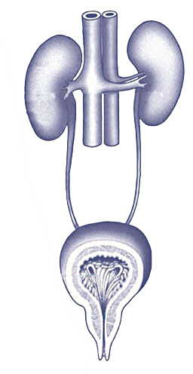
The Urinary System
Kidneys
Filter water & waste materials from the blood to form urine
Ureters
Transport urine from kidneys to the bladder
Bladder
Can expand to store urine & contract
to remove it
Urethra
Outlet tube from the bladder to outside the body
Notes:
• The urinary system consists of kidneys, ureters, the bladder and urethra
• The amount of urine is affected by the type & amount of fluid consumed. Normal urine is light yellow with very little odour. Around 1–1.5 litres is produced a day.

Slide 5
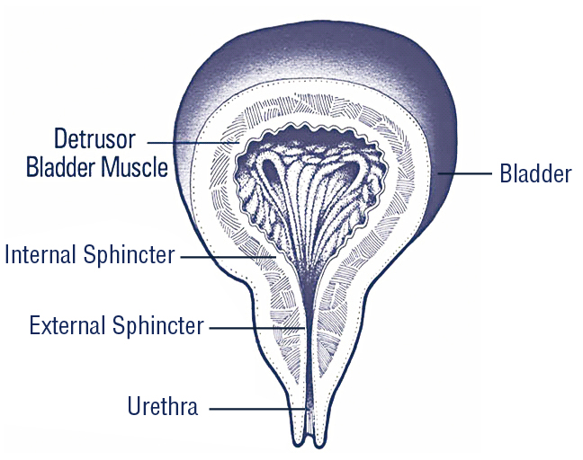
The Urinary System
At each end of the urethra are two muscular cuffs called sphincters that maintain bladder control
Notes:
• The bladder is a hollow muscular organ or sac. As is contracts, urine is pushed out by the Detrusor muscle
• There is voluntary control over the bladder contraction but no voluntary control over the Detrusor muscle contraction
• The male urethra is 20cm long & the female 3–5cm long

Slide 6
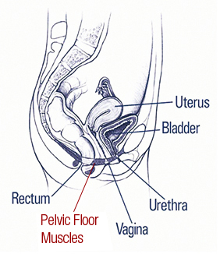
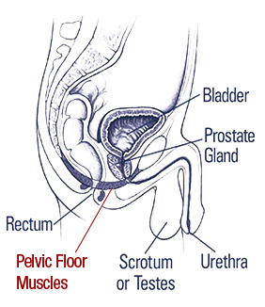
The Pelvic Floor
Female Tract
Male Tract
A large muscle slung across the pelvis from the front to back
Supports the pelvic & abdominal organs in correct position
TIP: Exercising pelvic floor muscles can help reduce incontinence symptoms.
Notes:
• Pelvic floor muscles exercises strengthen the muscles around the bladder & bladder opening.
• They’re recommended for men & women who experience any degree of urinary leakage
• To gain maximum benefit, it’s important the exercises are performed correctly

Slide 7
Pelvic Floor Exercises
Identify the correct muscles
Breathe normally
Tighten the muscles for 3–5 seconds
(As muscles strengthen hold for 10 seconds or more)
Relax for as long as muscles were tightened
Do 5–7 exercises at a time, 3 times a day
(Increase up to 15 exercises at a time,
3 times a day)
Notes:
• To find their pelvic floor muscles, people should tighten their rectum as if trying to control passing gas, pinching off a stool or stopping the flow of urine
• Do not tense leg, buttock or abdominal muscles & do not hold breath
• When men tighten pelvic floor muscles, the penis will move up & down
• Encourage people to seek advice from their doctor, nurse or therapist if they’re not sure they’re using the proper muscles

Slide 8
Incontinence Defined
The complaint of any involuntary leakage of urine or faeces
A major health problem affecting 3.8 million Australians
A symptom, not a disease
Can affect all ages, regardless of gender, race, colour, culture & socio-economic background
Notes:
• Incontinence is a debilitating disorder
• Effects can be physical, psychological, social & economical
• It can sometimes be cured or significantly improved and / or managed better with appropriate aids

Slide 9
Types of Incontinence
1. Stress incontinence
Leakage of small amounts of urine when coughing, sneezing, laughing, straining, lifting, playing sport
CAUSES: Pregnancy, childbirth, menopause;
Heavy lifting, obesity, constipation; Prostate surgery
2. Urge incontinence
Loss of urine associated with sudden strong
urge to urinate, often due to overactive or
unstable bladder
CAUSES: Parkinson’s disease, enlarged prostrate, constipation, diabetes, multiple sclerosis, stroke
Notes:
• Stress incontinence occurs mainly in women but occasionally in men
• With urge incontinence, some medications, foods & fluids (especially caffeine & alcohol) can irritate the bladder & cause ‘urgency’

Slide 10
Types of Incontinence
3. Overflow incontinence
Where the bladder does not
empty properly
CAUSES: Outlet obstruction, Nerve damage, Underactive bladder muscle, Some medications, Constipation, Dementia, Intellectual impairment
Notes:
• With overflow incontinence, possible causes include outlet obstruction such as enlarged prostrate or urethral stricture. It may also occur due to damage to nerves controlling the bladder or urethral sphincter

Slide 11
Types of Incontinence
4. Functional incontinence
Where the person’s ability to reach or use the toilet is compromised
CAUSES: A physical, mental, intellectual or environmental problem
5. Reflex incontinence
Loss of urine control due to damage to
the nerves which control bladder function
CAUSES: Spinal injuries
Notes:
• Expanding on the causes of Functional incontinence, these could be things like poor mobility, poor dexterity, loss of memory or poor building design

Slide 12
Attitudes & Impacts
Social embarrassment
Isolation (social & physical)
Guilt & shame
Anger & denial
Person being seen as
lazy or attention seeking
Skin complaints &
hygiene issues
Notes:
• Incontinence can have devastating effects on both the person suffering from it and their carers, family & significant others

Slide 13
This certifies that
Name:
has attended the continence management session
Module 1: Introduction to Urinary Incontinence
Date of Completion_______________________________

